Slide 1
I/O
Yubin Xia
IPADS, SJTU
ACKs: Some slides are adapted from the textbook’s original slides and frans’s os course notes

Slide 2
Review: What Can’t You Do in an Interrupt Handler?
You cannot sleep
or call something that might sleep
You cannot refer to current
You cannot allocate memory with GPF_KERNEL (which can sleep), you must use GPF_ATOMIC (which can fail)
You cannot call schedule()
You cannot do a down() semaphore call
However, you can do an up()
You cannot transfer data to/from user space
E.g., copy_to_user(), copy_from_user()

Slide 3
Review
FlexSC: Exception-less syscall: remove synchronicity by decoupling invocation from execution
Why I/O sub-system: Thousands of devices, each slightly different
Unified interface: file
Open, read, write, seek, close, …
Avoid too generalization
Top-half & bottom-half

Slide 4
The two main jobs of a computer are I/O and processing. In many cases, the main job is I/O, and the processing is merely incidental.
—— Operating System Concepts, 8th edition

Slide 5
I/O

Slide 6
Why do we Need an I/O Subsystem
Thousands of devices, each slightly different
How can we standardize the interfaces to these devices?
Devices are unreliable
Media failures and transmission errors
How can we make them reliable?
Devices are unpredictable and/or slow
How can we manage them if we don’t know what they will do or how they will perform?

Slide 7
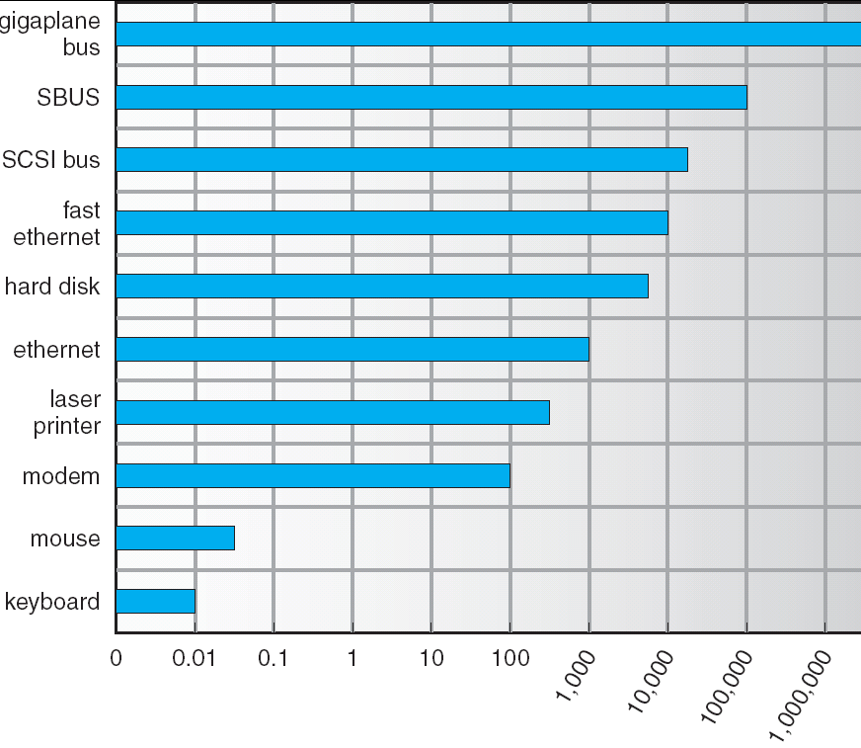
Device Rates Vary Many Orders of Magnitude
I/O subsystem better handle this wide range
Better not have high overhead/byte for fast devices!
Better not waste time waiting for slow devices

Slide 8
Goal of I/O Subsystem
Provides uniform interfaces, despite wide range of different devices
This code works on many different devices:
FILE fd = fopen(“/dev/something”,”rw”); for (int i = 0; i < 10; i++) { fprintf(fd,”Count %d\n”,i); } close(fd);
Why?
Because code that controls devices (“device driver”) implements standard interface.
Provides a layer of abstraction of I/O hardware
Manages and interacts with hardware
Hides hardware and operation details
Notes:
键盘、显示器、U盘为什么是文件？
游戏手柄？
Lidar？
Socket反例：send/recv
I/O device has its own CPU?

Slide 9
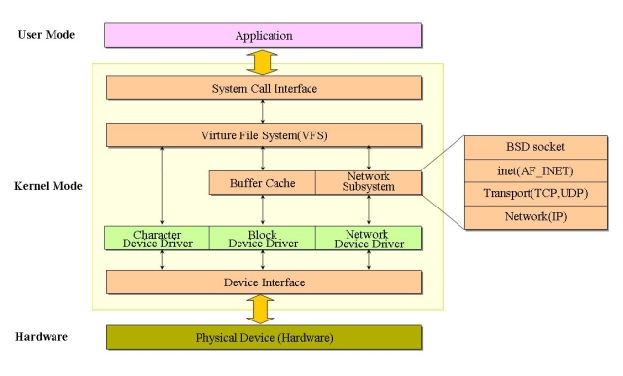
Three Types of Device Interfaces
Three common types of device interfaces
Character devices
Block devices
Network devices

Slide 10
Character Devices
Character Devices
Example: keyboard/mouse, serial port, some USB devices
Sequential access, single characters at a time
I/O commands: get(), put(), etc.
Often use open file interface and semantics

Slide 11
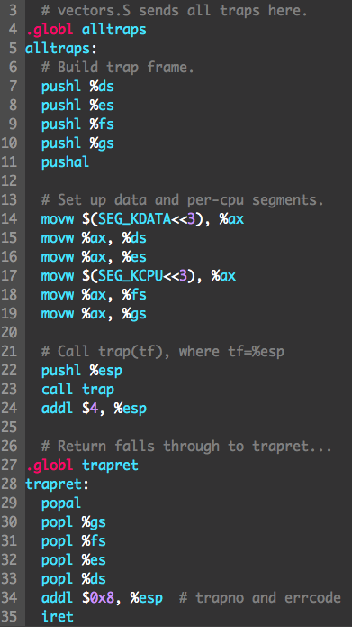
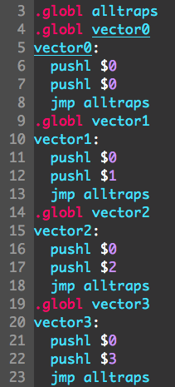
Press ‘a’ to display ‘a’

Slide 12
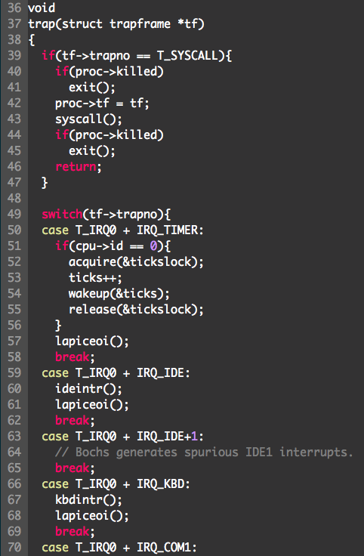
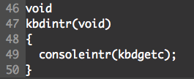
Function pointer

Slide 13
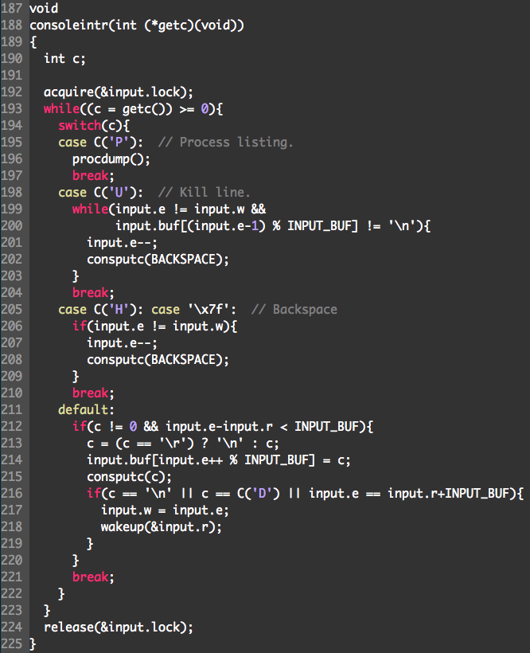
kbdgetc()
#define C(x) ((x)-’@’) // Control-x

Slide 14
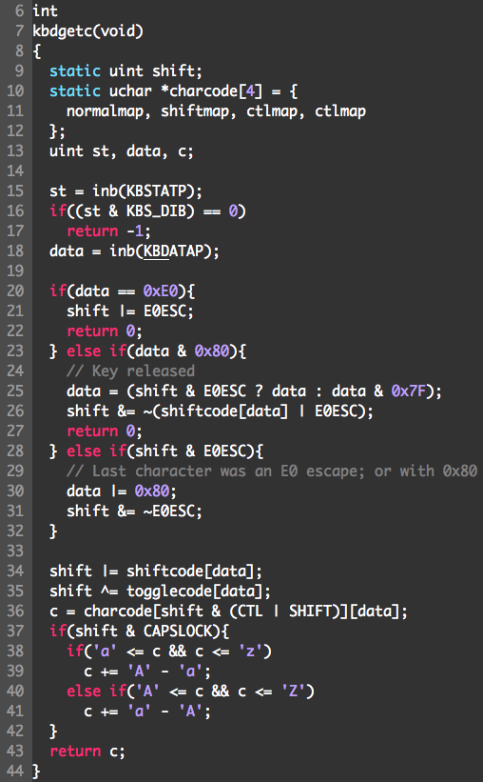
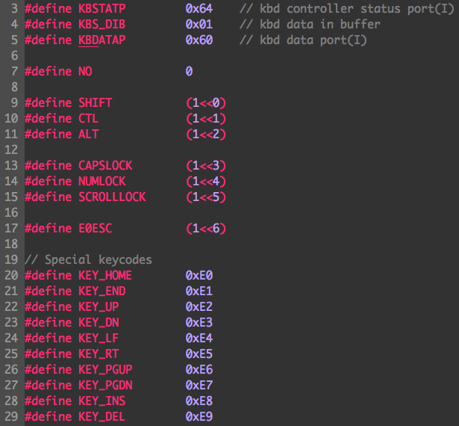

Slide 15
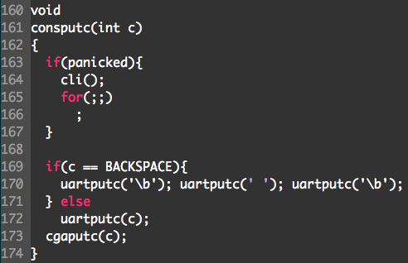
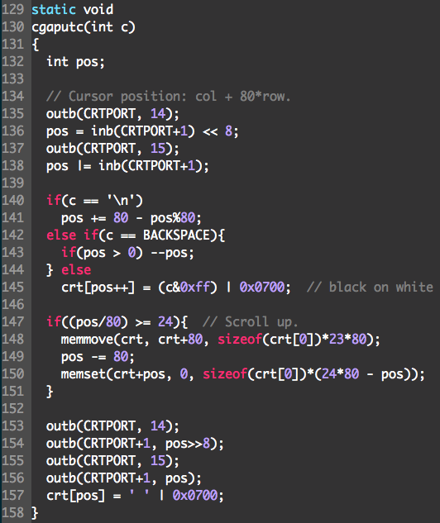
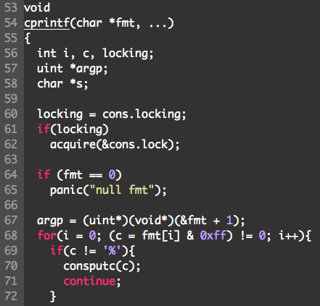

Slide 16
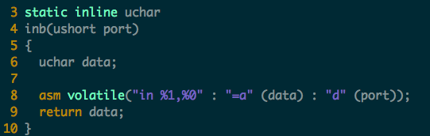
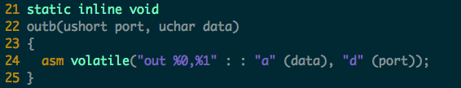
I/O instruction in xv6

Slide 17
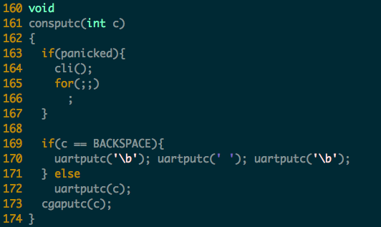
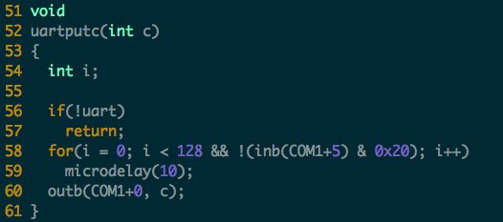
Notes:
UART: Universal Asynchronous Receiver/Transmitter (即串口)

Slide 18
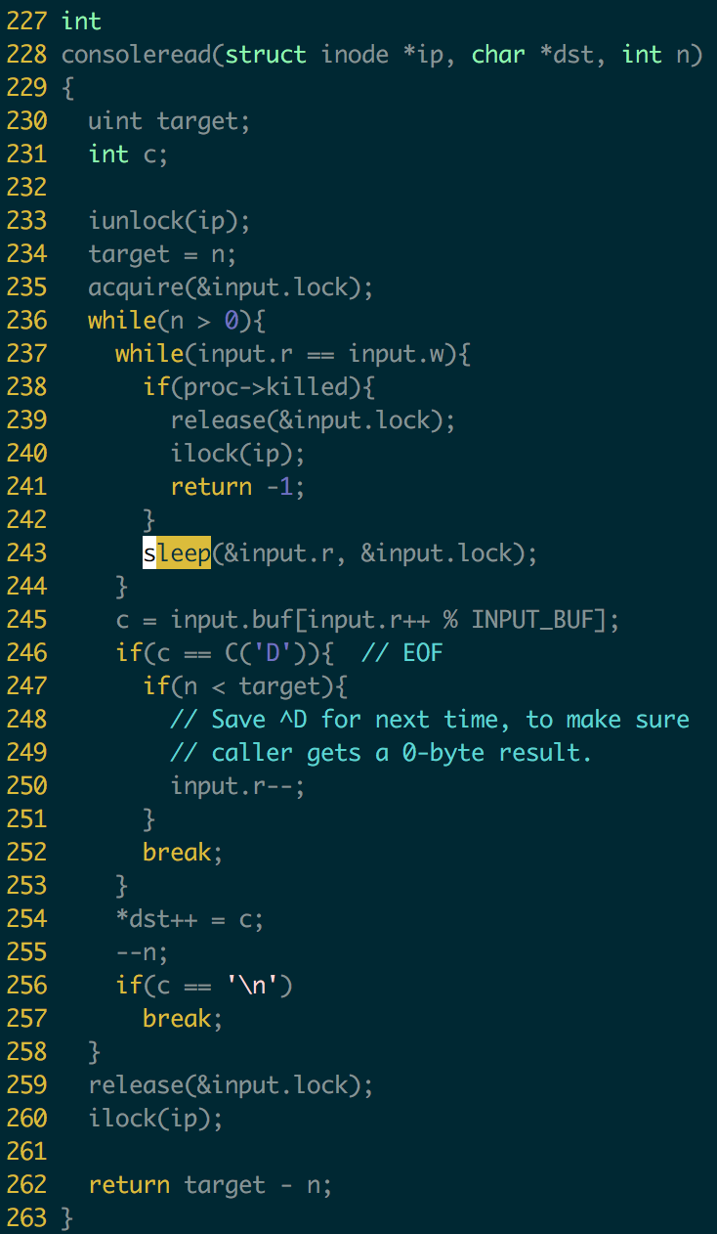
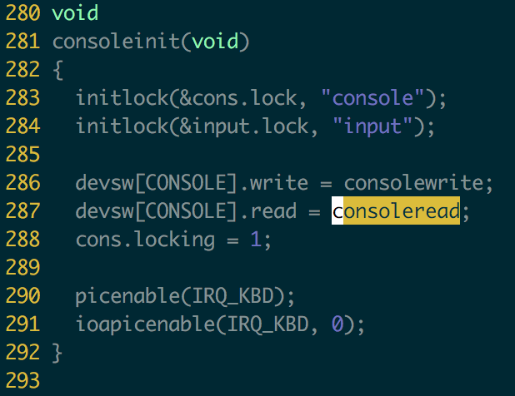
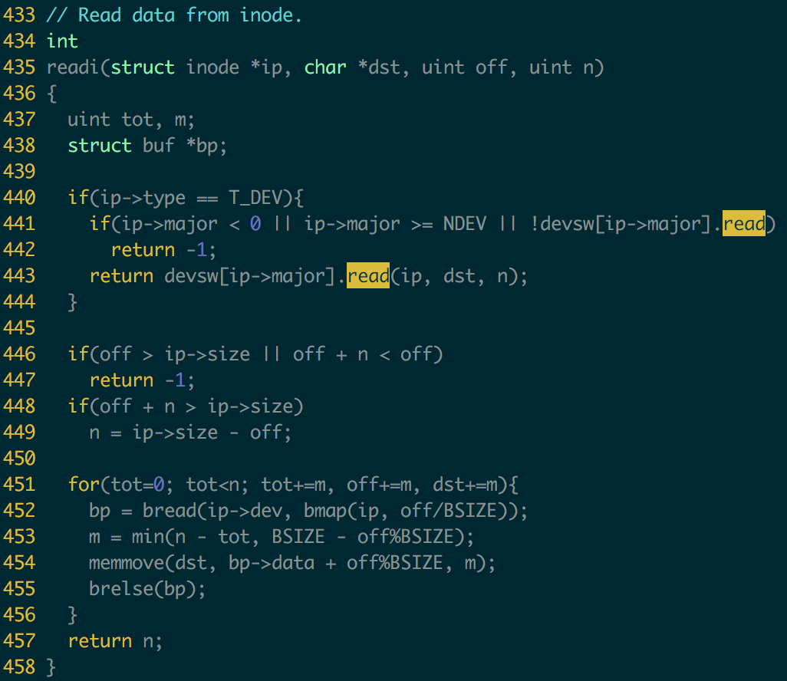

Slide 19
Block Devices
Block Devices
Example: disk drive, tape drive, DVD-ROM
Uniform block I/O interface to access blocks of data
Raw I/O or file-system access
Memory-mapped file access possible

Slide 20
Network Devices
Network Devices
Examples: Ethernet, wireless, bluetooth
Different enough from block/character to have own interface
Provide special networking interface for supporting various network protocols
For example, send/receive network packets

Slide 21
How Does User Deal with Timing?
Blocking I/O: “Wait”
When request data (e.g. read() system call), put process in waiting state until data is ready
When write data (e.g. write() system call), put process in waiting state until device is ready for data
Non-blocking I/O: “Don’t Wait”
Returns immediately from read or write request with count of bytes successfully transferred
Read may return nothing, write may write nothing
Asynchronous I/O: “Tell Me Later”
When request data, take pointer to user’s buffer, return immediately; later kernel fills buffer and notifies user
When send data, take pointer to user’s buffer, return immediately; later kernel takes data and notifies user

Slide 22
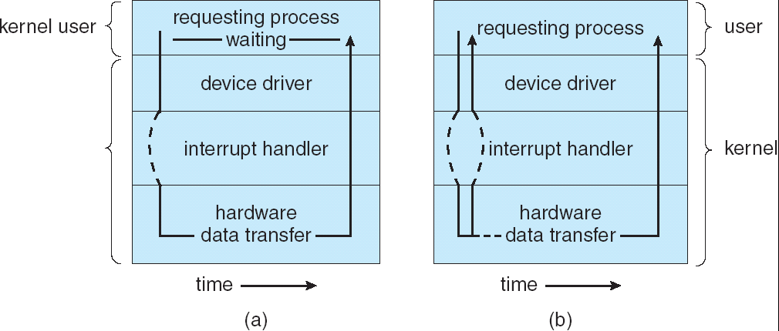
Synchronous and Asynchronous I/O

Slide 23
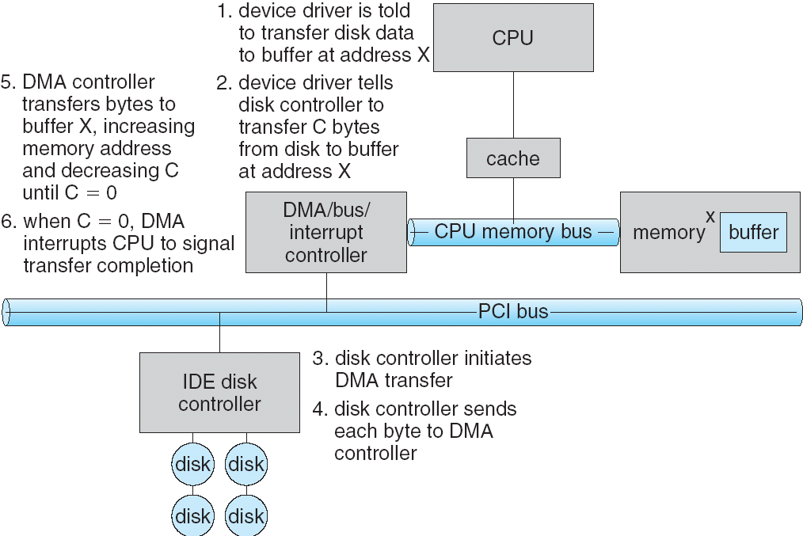
Steps in a DMA Transfer

Slide 24
I/O Device Notifying the OS
The OS needs to know when:
The I/O device has completed an operation
The I/O operation has encountered an error
Two methods
Polling
Interrupt-driven
Polling:
I/O device puts completion/error information in device-specific status register
OS periodically checks the status register
Pro: low overhead
Con: may waste many cycles on polling if infrequent or unpredictable I/O operations
Notes:
After the OS has issued a command to the I/O device either via a special I/O instruction or by writing to a location in the I/O address space, the OS needs to be notified when:
(a) The I/O device has completed the operation.
(b) Or when the I/O device has encountered an error.
This can be accomplished in two different ways: Polling and I/O interrupt.
+1 = 58 min. (Y:38)

Slide 25
Interrupt Driven
Pro: handles unpredictable events well
Con: interrupts relatively high overhead
Some devices may combine both polling and interrupt-driven
High-bandwidth network device example:
interrupt for first incoming packet
polling for following packets until hardware empty

Slide 26
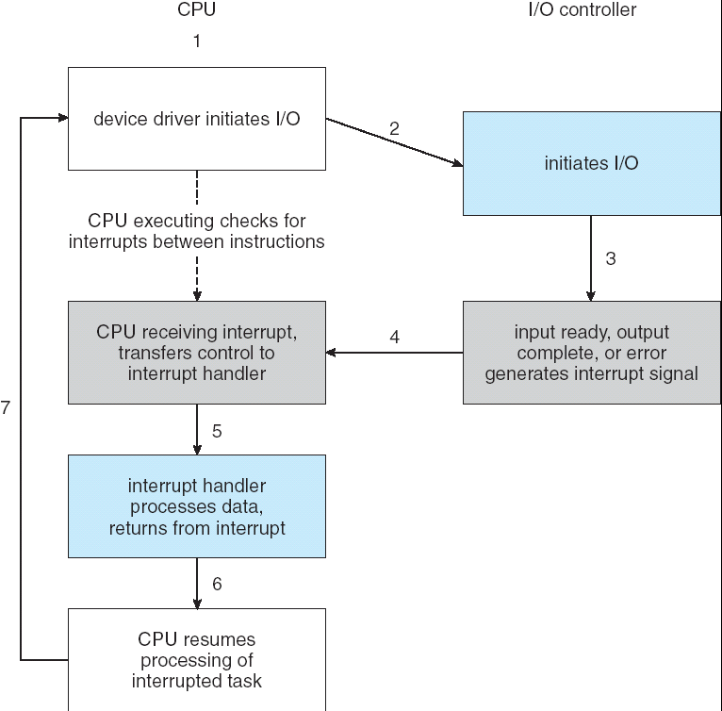
Interrupt-Driven I/O Cycle

Slide 27
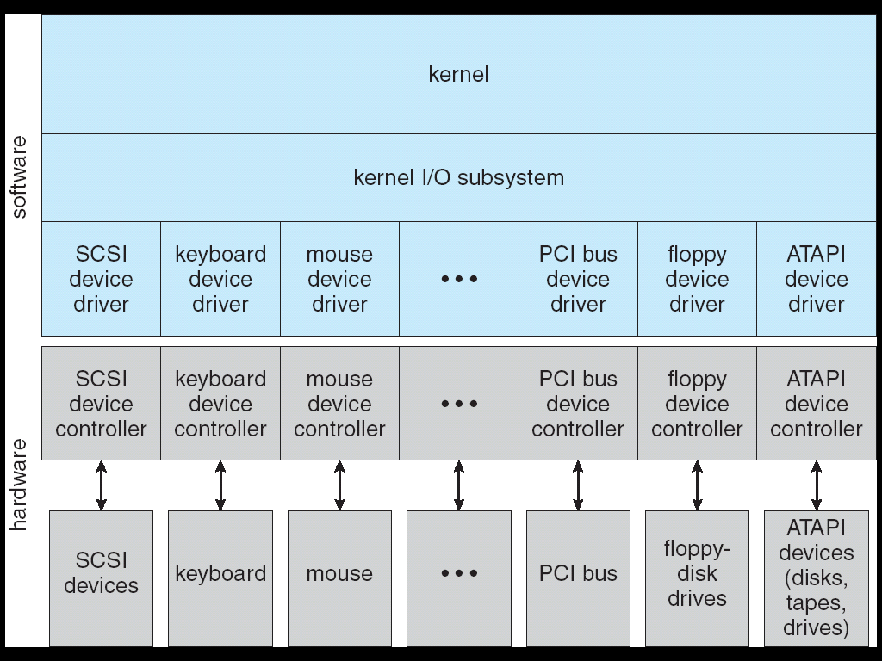
A Kernel I/O Structure

Slide 28
Device Drivers
Device-specific code in the kernel that interacts directly with the device hardware
Supports a standard internal interface
Same kernel I/O system can interact easily with different device drivers
Special device-specific configuration supported with the ioctl() system call
Device drivers typically divided into two pieces:
Top half
Bottom half

Slide 29
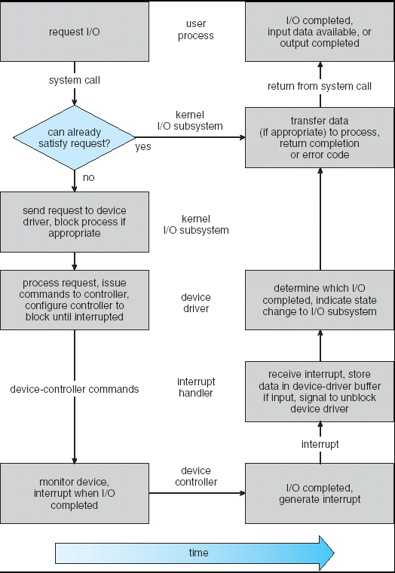
Life Cycle of An I/O Request
User
Program
Kernel I/O
Subsystem
Device Driver
Top Half
Device Driver
Bottom Half
Device
Hardware

Slide 30
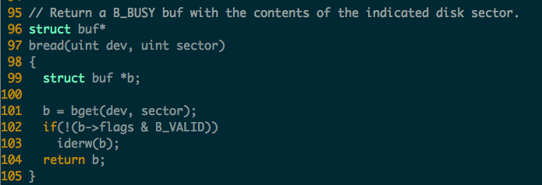
Recall : Read Disk
readi()->bread()
Call bget() to read from buffer cache first
If not found, call iderw() to read from disk, and mark as valid.

Slide 31
Xv6 disk driver design & Implementation
Design Overview
Support an IDE driver
Use I/O Instructions instead of Memory Mapped I/O
in, out
Asynchronous I/O model
Use a simple queue of I/O request
Use interrupt to notify the available of data

Slide 32
IDE Specification
Xv6 uses a relative old IDE specification
Not PCI negotiation
IDE Ports
0x1F0-0x1F7
0x1f0: write/read port
0x1f2: number of sectors
0x1f3-0x1f5: sector number
0x1f6: diskno and sector number
0x1f7: command registers, status bit
0x3F6 interrupt control line

Slide 33
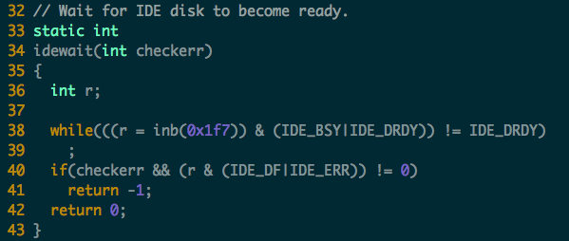
Polling Mechanism

Slide 34
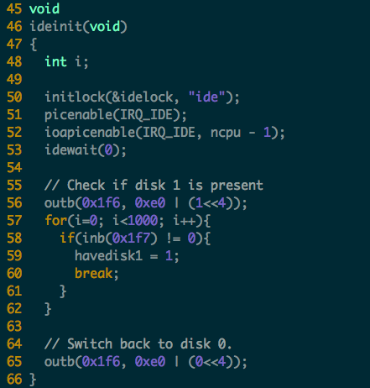
IDE Initialization

Slide 35
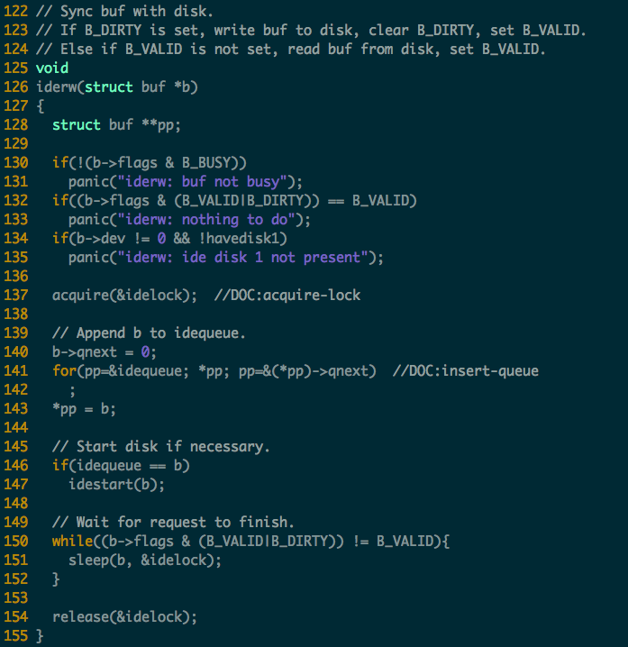
Synchronous I/O (iderw)

Slide 36
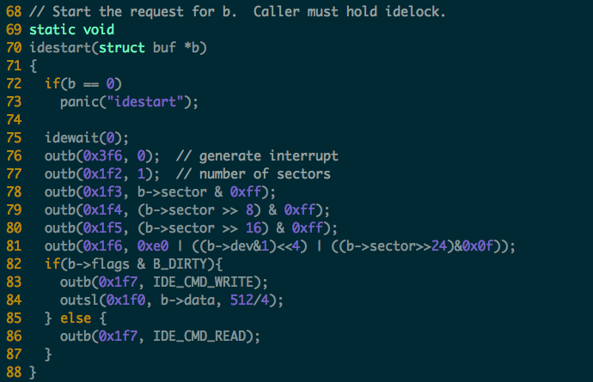

Slide 37
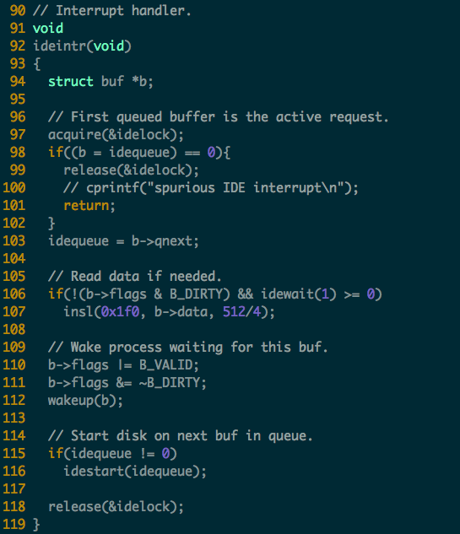

Slide 38
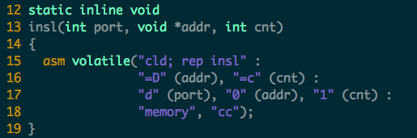

Slide 39
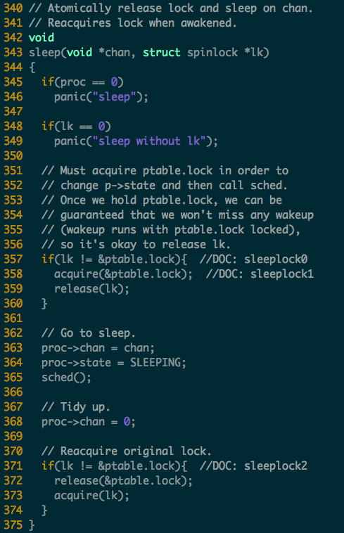
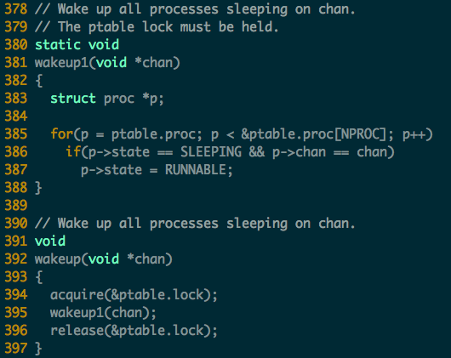
Sleep and Wakeup Mechanism in xv6

Slide 40
IDE.c
The driver can only handle 1 operation at a time
Only send the buffer at the front of the queue
Others are simply waiting their turn
iderw() maintains a queue of requests
Adds the buffer b to the end of the queue
If b is the first, then call idestart(), if not, just wait
Then just sleep, instead of polling
ideintr() will handle the first request
Then start other request if any

Slide 41
Homework
Please read xv6 code and describe the process of helloworld (from “./hello” to the exit)

